Slide 1
PROJECT MANAGEMENT

Slide 2
Project – a [temporary] sequence of unique, complex, and connected activities having one goal or purpose and that must be completed by specific time, within budget, and according to specification.

Slide 3
A project is an effort that involves a series of activities and resources, aimed to achieve a certain. output, considering constraints like time, quality and cost and which often introduces a change

Slide 4
INTRODUCTION:
Project management – the process of scoping, planning, staffing, organizing, directing, and controlling the development of an acceptable system at a minimum cost within a specified time frame.
Project management is the application of processes, methods, skills, knowledge and experience to achieve specific project objectives according to the project acceptance criteria within agreed parameters. Project management has final deliverables that are constrained to a finite timescale and budget.

Slide 5
Measures of Project Success
The resulting information system is acceptable to the customer.
The system was delivered “on time.”
The system was delivered “within budget.”
The system development process had a minimal impact on ongoing business operations.

Slide 6
Types of Projects
Manufacturing Projects:
vehicle, ship, aircraft, a piece of machinery etc.
(2) Construction Projects:
buildings, bridges, roads, tunnels etc. CHINA PAKISTAN ECONOMIC CORRIDOR.

Slide 7
Types of Projects
(3) Management Projects:
This includes the organization or reorganization of work without necessarily producing a tangible result. Examples would be the design and testing of a new computer software package, relocation of a company’s headquarters or the production of a stage show.

Slide 8
Causes of Project Failure
Failure to establish upper-management commitment to the project
Lack of organization’s commitment to the methodology
Taking shortcuts through or around the methodology
Poor expectations management
Feature creep– uncontrolled addition of technical features to a system.
Scope creep – unexpected and gradual growth of requirements during an information systems project

Slide 9
Project Management Functions
Scoping – setting the boundaries of the project
Planning – identifying the tasks required to complete the project
Estimating – identifying the resources required to complete the project
Scheduling – developing the plan to complete the project
Organizing – making sure members understand their roles and responsibilities
Directing – Directing the project processes.
Controlling – monitoring progress
Closing – assessing success and failure

Slide 10
Role of project management:
Leading organizations across sectors and geographic borders have been steadily embracing project management as a way to control spending and improve project results. When the recession began, this practice became even more important. Executives discovered that adhering to project management methods and strategies reduced risks, cut costs and improved success rates—all vital to surviving the economic crisis
The project management approach creates a consistent level of governance, leadership, monitoring and reporting for projects

Slide 11
Role of project management
Implementing project management across the organization helps create a strategic value chain that gives companies an edge on their competitors, particularly in high-risk sectors and markets.
Being able to deliver projects on time and within budget often determines whether a company will get the next job or whether its new product hits the market.

Slide 12
Role of project management
A strong project management discipline brings exceptional value to the business.
To keep that competitive edge, companies need to align their project management strategies directly with their strategic business goals.

Slide 13
PROJECT LIFE CYCLE

Slide 14
Introduction
A project life cycle is the sequence of phases that a project goes through from its initiation to its closure.
Projects follow a predictable pattern or life cycle. A project life cycle consists of several stages during which deliverables are created and end with approval of the deliverables.

Slide 15
Introduction
The number and sequence of the cycle are determined by the management and various other factors like needs of the organization involved in the project, the nature of the project, and its area of application. The phases have a definite start, end, and control point and are constrained by time.

Slide 16
Introduction
A standard project typically has the following four major phases (each with its own agenda of tasks and issues): initiation, planning, implementation, and closure. Taken together, these phases represent the path a project takes from the beginning to its end and are generally referred to as the project life cycle

Slide 17
PROJECT LIFE CYCLE STAGES:
The Initiation Phase: Starting of the project.
The initiation phase aims to define and authorize the project. The project manager takes the given information and creates a Project Charter. The Project Charter authorizes the project and documents the primary requirements for the project. It includes information such as:
Project’s purpose, vision, and mission
Measurable objectives and success criteria
Elaborated project description, conditions, and risks
Name and authority of the project sponsor
Concerned stakeholders

Slide 18
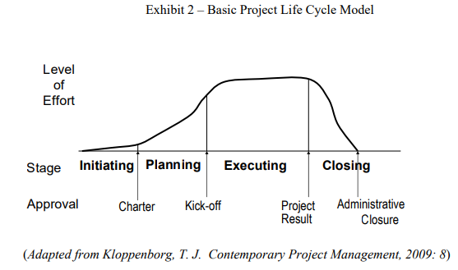

Slide 19
PROJECT LIFE CYCLE STAGES:
2. The Planning Phase: The purpose of this phase is to lay down a detailed strategy of how the project has to be performed and how to make it a success. Project Planning consists of two parts:
Strategic Planning
Implementation Planning
In strategic planning, the overall approach to the project is developed. In implementation planning, the ways to apply those decisions are sought

Slide 20
PROJECT LIFE CYCLE STAGES:
3. The Execution Phase: In this phase, the decisions and activities defined during the planning phase are implemented. During this phase, the project manager has to supervise the project and prevent any errors from taking place. This process is also termed as monitoring and controlling.

Slide 21
PROJECT LIFE CYCLE STAGES.
4. CLOSE-OUT : The final phase of the project life cycle is close-out and demobilization, where resources are reassigned, the project is handed over and the post-project review is carried out.

Slide 22
Software project development life cycle

Slide 23
Software project development life cycle
Software Development Life Cycle (SDLC) is a process used by the software industry to design, develop and test high quality software. The SDLC aims to produce a high-quality software that meets or exceeds customer expectations.

Slide 24
Software project development life cycle
SDLC is a process followed for a software project, within a software organization. It consists of a detailed plan describing how to develop, maintain, replace and alter or enhance specific software. The life cycle defines a methodology for improving the quality of software and the overall development process.

Slide 25
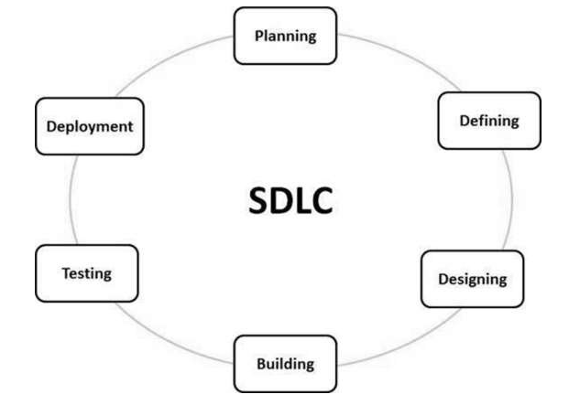
Software project development life cycle

Slide 26
Software project development life cycle
Stage 1: Planning and Requirement Analysis
Requirement analysis is the most important and fundamental stage in SDLC. It is performed by the senior members of the team with inputs from the customer, the sales department, market surveys and domain experts in the industry. This information is then used to plan the basic project approach and to conduct product feasibility study in the economical, operational and technical areas.

Slide 27
Software project development life cycle
Stage 2: Defining Requirements
Once the requirement analysis is done the next step is to clearly define and document the product requirements and get them approved from the customer or the market analysts. This is done through an SRS (Software Requirement Specification) document which consists of all the product requirements to be designed and developed during the project life cycle.

Slide 28
Software project development life cycle
Stage 3: Designing the Product Architecture
SRS is the reference for product architects to come out with the best architecture for the product to be developed. Based on the requirements specified in SRS, usually more than one design approach for the product architecture is proposed and documented in a DDS - Design Document Specification.
A design approach clearly defines all the architectural modules of the product along with its communication and data flow representation with the external and third party modules (if any).

Slide 29
Software project development life cycle
Stage 4: Building or Developing the Product
In this stage of SDLC the actual development starts and the product is built.
Developers must follow the coding guidelines defined by their organization and programming tools like compilers, interpreters, debuggers, etc. are used to generate the code. Different high level programming languages such as C, C++, Pascal, Java and PHP are used for coding. The programming language is chosen with respect to the type of software being developed.

Slide 30
Software project development life cycle
Stage 5: Testing the Product
This stage is usually a subset of all the stages as in the modern SDLC models, the testing activities are mostly involved in all the stages of SDLC. However, this stage refers to the testing only stage of the product where product defects are reported, tracked, fixed and retested, until the product reaches the quality standards defined in the SRS.

Slide 31
Software project development life cycle
Stage 6: Deployment in the Market
Once the product is tested and ready to be deployed it is released formally in the appropriate market. Sometimes product deployment happens in stages as per the business strategy of that organization.
Then based on the feedback, the product may be released as it is or with suggested enhancements in the targeting market segment. After the product is released in the market, its maintenance is done for the existing customer base.

Slide 32
Examples of computer based projects
Student Career And Personality Prediction Android Application
Online Shopping Android Application
Android Based Complaint Management System
Disease Prediction Android Application using Machine Learning
Android Password Based Remote Door Opener System Project
Density Based Traffic Controlling System With Android Override
Android Controlled Notice Board Project

Slide 33
Standard Methodologies used for project management

Slide 34
Introduction
A methodology is a system of practices, techniques, procedures and rules used by those who work in a discipline.
PM methodologies mean simply the best practice frameworks we mash together to get projects done.

Slide 35
Introduction
Choosing the right methodology is important because it defines how we work. It provides the structures that can guide us toward project success or failure. And since you already know there is no one-size-fits-all method that works for all business types, sizes or industries, it’s important that you put some time and effort into choosing the right project management methodology for your context.

Slide 36
Standard methodology
Lean methodology promotes maximizing customer value, while minimizing waste. It aims to create more value for the customer by using fewer resources. Stemmed from the Japanese manufacturing industry, its values suppose that ‘as waste is eliminated, quality improves while the production time and cost are reduced.

Slide 37
Standard methodology
Six Sigma is project management methodology first introduced by engineers at Motorola in 1986. It aims to improve quality by reducing the number of errors in a process by identifying what is not working and then removing it from the process. It uses quality management methods, which are mostly empirical and statistical, as well as the expertise of people who are specialists in these methods.

Slide 38
Critical Path Method
Technique for modeling and scheduling project activities used in industries like construction, software development, and engineering. In this method, you determine the activities needed to complete a project, the time that each will take, the dependencies between them. This methodology is used to calculate the longest and shortest paths to completing your project, which helps you understand the key activities of the project—which activities can be delayed and which activities can’t.

Slide 39
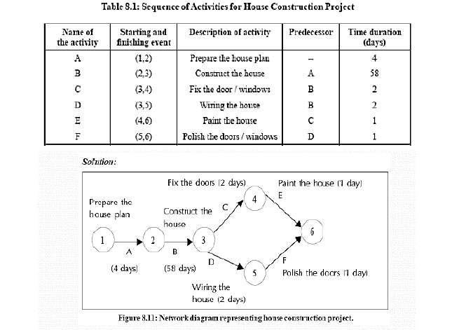

Slide 40
PERT
PERT stands for Program/project Evaluation Review technique.
A technique analyzes all tasks involved in completing a project.
Focuses on time control.
Uses probabilistic estimates.

Slide 41
PERT
There are three estimation times involved in PERT:
Optimistic Time (TO)
Most Likely (TE)
Pessimistic Time (TP).

Slide 42
PERT was developed during the 1950s through the efforts of the U.S. Navy and some of its contractors working on the Polaris missile project. Concerned about the growing nuclear arsenal of the Soviet Union, the U.S. government wanted to complete the Polaris project as quickly as possible. The Navy used PERT to coordinate the efforts of some 3,000 contractors involved with the project. Experts credited PERT with shortening the project duration by two years. Since then, all government contractors have been required to use PERT or a similar project analysis technique for all major government contracts

Slide 43
WORK BREAK DOWN STRUCTURE AND PROJECT SCHEDULING METHODS

Slide 44
The Work Break Down Structure (WBS)
An organizational tool for complex projects
A first step in creating a schedule
Useful for defining the Scope of Work
After decided how to do the work
Consists of:
Goal statement for project
Subdividing goal into smaller & smaller portions

Slide 45
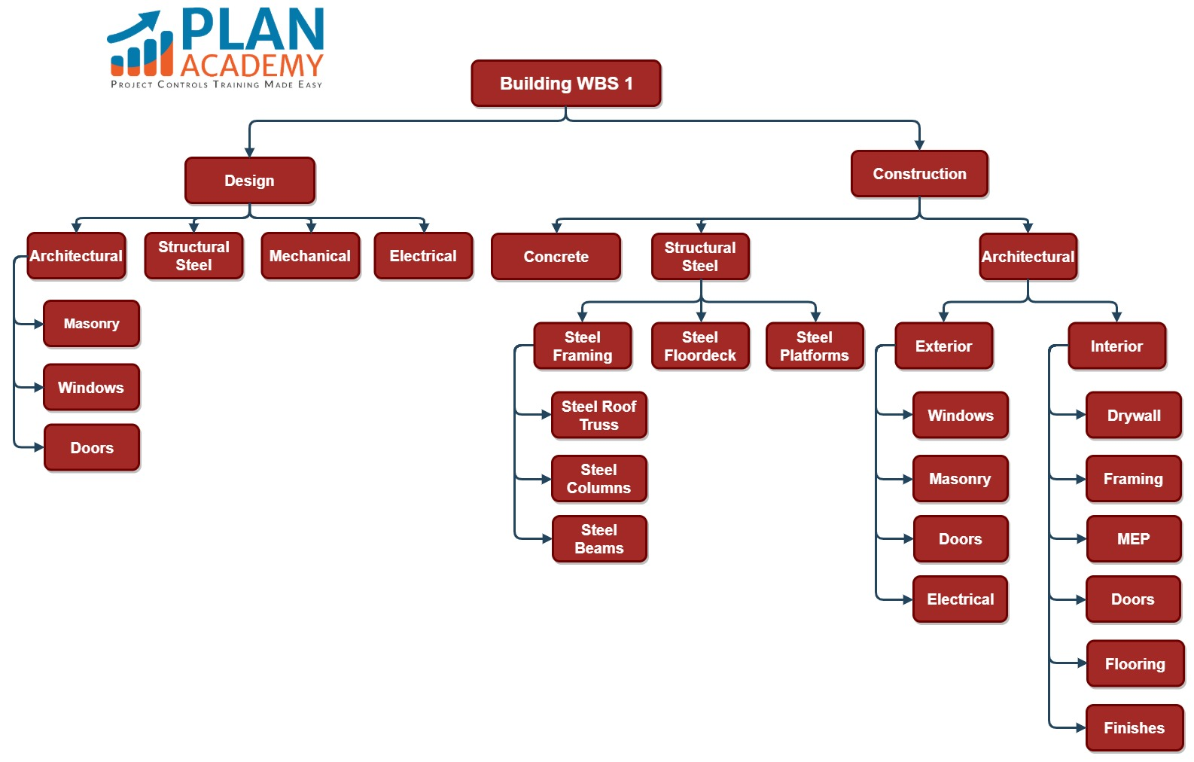
Work break down structure examples

Slide 46
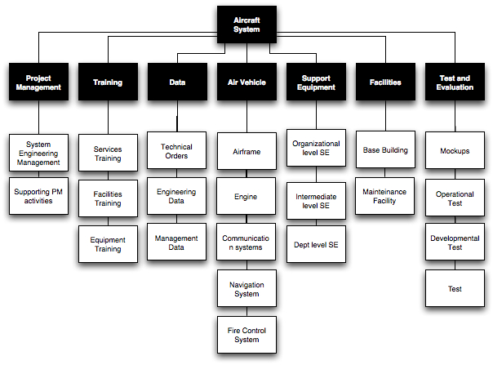

Slide 47
PROJECT SCHEDULING METHODS
The Most commonly used methods are :-
GANTT CHART:
A graphical representation of a Project that shows each task as a horizontal bar whose length is proportional to its time for completion.
A GANTT Chart is a horizontal bar chart that illustrates a Project schedule.
In the GANTT Chart Time is displayed on the horizontal axis and the Tasks/ Activities are arranged vertically from top to bottom, in order of their start dates.

Slide 48
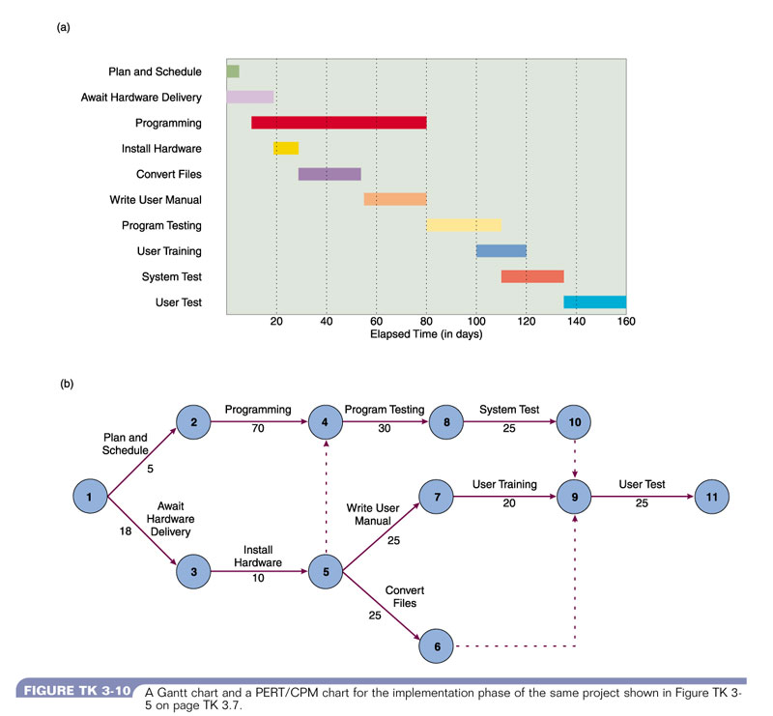

Slide 49
PROJECT SCHEDULING METHODS
2. PERT CHART:
A PERT chart is a tool that can help project managers schedule, organize and coordinate tasks in their projects. It's a graphic representation of the timeline of a project.

Slide 50
PERT CHART:
Task:
In Visual model, a Task has:
Task Name
Task ID
Duration
Start Date and End Date
 | Dependency: Links connect project tasks to indicate the time dependency relationship among them | Lane: A lane allows you to arrange your Pert Chart into horizontal zones separated by lines.

Slide 51
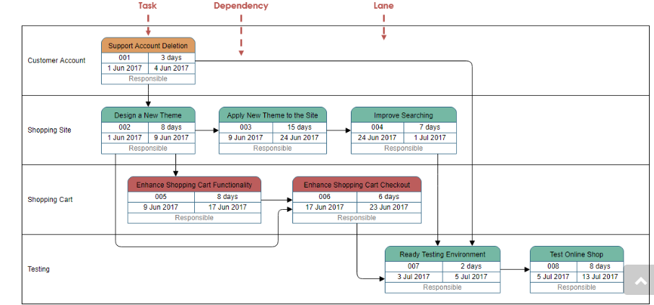

Slide 52
PROJECT RESOURCES

Slide 53
Project Resources
A resource is a necessary asset whose main role is to help carry out a certain task or project. A resource can be a person, a team, a tool, finances, and time. Most projects require many different resources in order to be completed.
Project resources are the people, capital, and/or material goods required for the successful execution and completion of a project.

Slide 54
Resource allocation
Resource allocation helps you to choose the best available resources for your projects and manage them throughout the work, so you can avoid under or overutilization of your employees. Sadly, not all project managers use it to their advantage.

Slide 55
Types of resources
All resources of project management process are important to get the project off the ground and successfully move it in the right direction. The more effort you put into thinking through these three types of project resources you will certainly need and start providing in advance to ensure that they are ready for you when you need them, the easier it will be for you to complete your project on time and on budget.

Slide 56
Types of resources
People (Work Resources):
Human resources are considered to have the most complex requirements than the other two types of project resources. Therefore, project managers should plan in advance and identify potential people to become part of the project team by making sure they are available and skilled for the project .

Slide 57
Types of resources
2) Capital (Cost Resources):
The second essential resource for successful project completion is capital. Generally, managing a budget for a particular project is one of the core skills that all project managers must have. As a project manager you need to be confident handling finances and costs so that every phase of the project goes smoothly.

Slide 58
Types of resources
3) Material Goods (Material resources):
Projects also use up material resources that include different materials, supplies and/or items that are part of the project. Examples include:
Software licenses
Hardware like technical infrastructure such as cabling or switches for the IT equipment
Equipment or machinery

Slide 59
How to allocate resources
Know the project and the team.
Identify the risks. i.e delays due to emergencies
Focus the right track of project.
Analyze the project (collection of past and present data).

Slide 60
ADVANTAGES
Maximizing resource efficiency: Resource Utilization
Getting a bird's eye view of your project: An overview
Preventing miscommunication mishaps: Transparency
Predicting the future: Foreseeing and avoiding problems
Taking Control.

